Slide 1


Notes:
Hello and welcome to the Town of Franklin’s 2023 Open Space and Recreation Plan Update video. My name is Breeka Li Goodlander and I am the Conservation Agent/Natural Resource Protection Manage for the Town. I will be guiding you through this video today to hopefully answer questions you may have about what the Open Space and Recreation Plan is, why it is important, and how to get involved and provide feedback. I am very excited to be here so let’s get started.

Slide 2


Slide 3

What is the Open Space and Recreation Plan?
Open Space and Recreation Plan = “OSRP”
“A tool through which a community plans for the future of its conservation and recreation resources.” (Mass.gov, 2022)
A plan for plans
Accumulation of public participation, stakeholder engagement, goals and objectives
Source of funding: approved OSRPs are eligible for grant programs for up to 7 years
A way to connect with residents about local conservation and recreation issues
Notes:
An Open Space and Recreation Plan, otherwise known as an OSRP, is a tool through which a community plans for the future of its conservation and recreation resources. In other words, it is a “plan for plans”. The OSRP is an accumulation of public participation and stakeholder engagement to identify and prioritize the goals and objectives of the community as it relates to Open Space and Recreation lands and facilities. Through OSRPs identified goals and objectives can be funded through various grant programs for up to 7 years. OSRPs are also a great way to connect with residents about local conservation and recreation issues.

Slide 4

Overview and Benefits of the OSRP
Provides a snapshot of community priorities from stakeholder feedback and public engagement
Guides policy decisions for open space, climate resiliency, natural resources, and recreational issues
Maintain public spaces and recreational facilities
Protects open spaces, habitat, and biodiversity
Develops and implements a capital improvement program
Improves public access and awareness
Source of funding

Slide 5


OSRP Requirements
Plan summary - overall aspirations of the community
Introduction - statement of purpose, planning process, and public participation
Community setting - regional context, community history, demographics, etc.
Environmental inventory and analysis - water resources, fisheries, wildlife, etc.
Inventory of Lands - ownership, use, condition, and potential of parcels
Community vision - description of how the community vision was obtained
Analysis of needs - summary of resource protection, community, and management needs
Goals and objectives - comprehensive set of goals and objectives identified
Action Plan - year-by-year timetable for specific actions to accomplish
Public comments - all public comments submitted during the OSRP process
References - all reference documents used

Slide 6

What is “Open Space”?
Private Lands
Private recreational areas
Lands under special taxation programs (Chapter 61/A/B)
Other non-protected, private parcels
Public Lands
Town owned “Conservation” and “Recreation” lands and resources
Non-profit lands (i.e. Metacomet)
Federal and State owned lands (i.e. State forest)
Notes:
Open Space can be broken up into two distinct type of lands – private and public

Slide 7

What is Recreation?
Programs
Indoor and outdoor facilities
Parks
Playgrounds
Multi-use fields
Courts

Slide 8
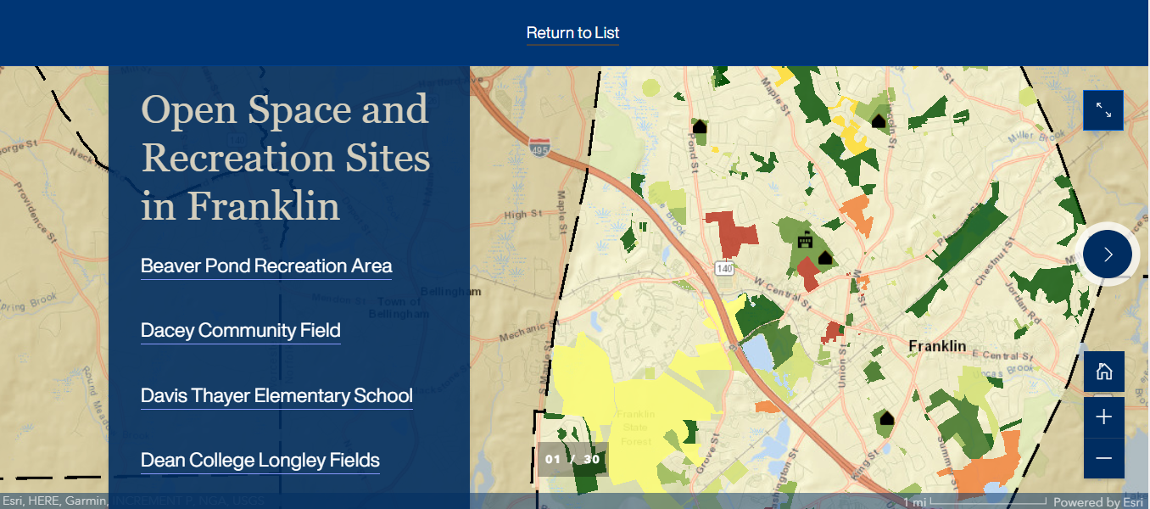
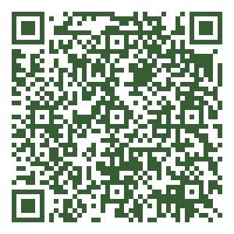
Open Space and Recreation Sites in Franklin
https://www.franklinma.gov/conservation/webforms/open-space-and-recreation-areas

Slide 9

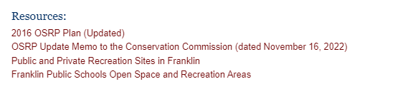
Public and Private Recreation Inventory
https://www.franklinma.gov/conservation/files/public-and-private-recreation-sites-franklin
On the OSRP webpage…

Slide 10

Public Schools Open Space and Recreation Areas
https://www.franklinma.gov/conservation/files/franklin-public-schools-open-space-and-recreation-areas
On the OSRP webpage…

Slide 11

Summary of the 2016 Survey
88.2% of households reported they were supportive of Town appropriations for acquisition of Open Space
85.3% of households reported they were supportive of Town appropriations for additional recreational facilities
Households were equally in agreement that the Town should prioritize improving existing recreational facilities, acquiring/building additional recreational facilities, and acquiring conservation lands for passive recreation
Walking was the most reported recreational activity amongst all age groups (639 households)
Bike trails were identified ranked as the most needed recreational facility needed among residents
60.7% of residents reported that they would sell land to the Town at a fair market price to preserve Open Space
Water resources and wildlife habitat ranked highest in important for preservation
Notes:
Including but not comprehensive

Slide 12
Accomplishments since the 2016 OSRP
Acquired the Riverbend Open Space Area
Improved the surface of the SNETT system
Signage at every field and open space area
Parking analysis at open space areas
Recycling receptacles at all recreation areas
Constructed shared use path to a portion of Grove Street and sharrows to some side streets
Increased the Open Space Fund
Secured capital funding
Sidewalks were added to portions of Chestnut Street and Pleasant Street, Beaver Street, and Lincoln Street

Slide 13
Accomplishments since the 2016 OSRP
Transferred Town owned tax title and unresolved parcels to the Conservation Commission for designation as “Conservation” lands and permanent protection
Evaluated local fee and tax structures to create a permanent revenue stream
Acquired land adjacent to existing (circa 2016) recreation areas that were suitable for future “Conservation” land or additional recreation areas
Conducted community outreach for the Community Preservation Act (CPA) and had the CPA on the Town ballot

Slide 14

OSRP Update Process (Jan 2023 - Aug 2023)
Bimonthly focus group meetings
Digital citizen survey
February 13, 2023 - April 16, 2023
Three public hearings
February 2023 – 2016 OSRP Review and Current Priorities
April 2023 – Goals & Objectives for 2023 OSRP
June 2023 – Draft 2023 OSRP review
Comment period
Month long public comment period to gather input regarding the draft Plan
Conservation, Council, and State approval
Notes:
In order to develop a Plan that represents the opinions, desires, and needs of the community, there will be multiple ways the Town will be receiving feedback from residents and organizations. The Franklin Conservation Commission will hold bimonthly OSRP update meetings and three public hearings to meet and discuss the needs and concerns of the community. A survey will be distributed in order to understand the needs and concerns of the residents of Franklin. The survey will be distributed before the first public hearing in February 2023 and will run for approximately two months. The survey results will be presented at the second public hearing in April. Once the 2023 OSRP Draft is developed, a month long comment period will occur, which will include the public hearing in June, to gather input regarding the draft plan. At any time during the Plan update process, individuals will be able to provide comments or suggestions in any method shown on the following slide.

Slide 15

Get Involved
Visit the OSRP Webpage
https://www.franklinma.gov/conservation/pages/2023-open-space-and-recreation-plan-update
Sign up for Conservation news alerts
franklinma.gov/subscribe
Conservation calendar
https://www.franklinma.gov/node/24/events/month
Office hours: alternating Fridays 10a - 11a in Room 326A at Town Hall
Provide input by Google Form, email, or survey
Google Form: https://forms.gle/GLJ88MHhykuCmw4y6
Email: bgoodlander@franklinma.gov
Survey posted on all digital platforms Feb 2023 - April 2023
Contact Breeka Li Goodlander for more information or a hardcopy
Attend the public hearings
Paper comment
Digital comment
Public comment
Schedule an OSRP presentation for your group or organization
Contact bgoodlander@franklinma.gov for more information

Slide 16






Get Involved
OSRP Survey
OSRP Google Form
Subscribe
Event Calendar
Breeka Li Goodlander, CWS, PWS, CERPIT bgoodlander@franklinma.gov
508-520-4847
OSRP Webpage
Disclaimer: Song “9” provided by Matt LeGroulx at https://freemusicarchive.org/music/Matt_LeGroulx/contact

